Slide 1
이츠 유얼 턴 (Intel Edge AI Project)
5조
김승민
박민혁
유지승
조수환

Slide 2
목차
60%
80%
프로젝트 수행
-데이터 수집 및 전처리
-AI모델학습
-기능구현
-UI개발
-시스템 통합
수행결과
-신호등,표지판인식 영상
-차량인식 영상
-테블릿 영상
-실제 차량 시현영상
20%
90%
프로젝트 구조
-시스템 구상도
-프로젝트 일정
사후평가
-어려웠던점
-느낀점
10%
100%
프로젝트 개요
-프로젝트 배경
-목표 및 기대효과
-팀구성 및 역할
QnA

Slide 3
목차
60%
80%
프로젝트 수행
-데이터 수집 및 전처리
-AI모델학습
-기능구현
-UI개발
-시스템 통합
수행결과
-신호등,표지판인식 영상
-차량인식 영상
-테블릿 영상
-실제 차량 시현영상
20%
90%
프로젝트 구조
-시스템 구상도
-프로젝트 일정
사후평가
-어려웠던점
-느낀점
10%
100%
프로젝트 개요
-프로젝트 배경
-목표 및 기대효과
-팀구성 및 역할
QnA

Slide 4
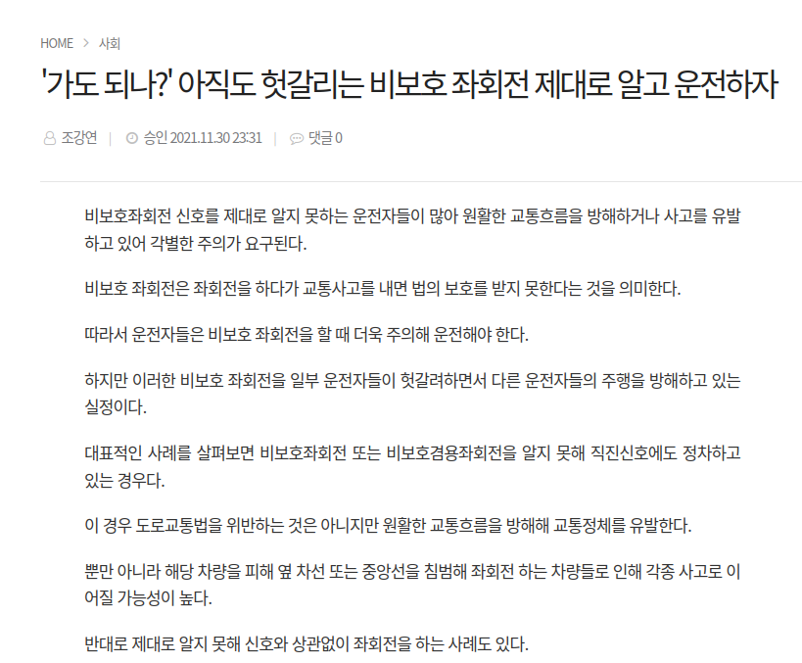
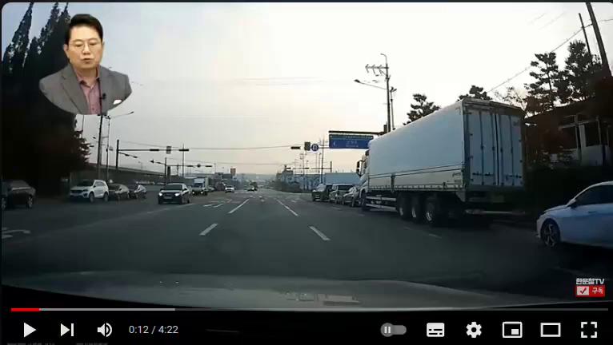
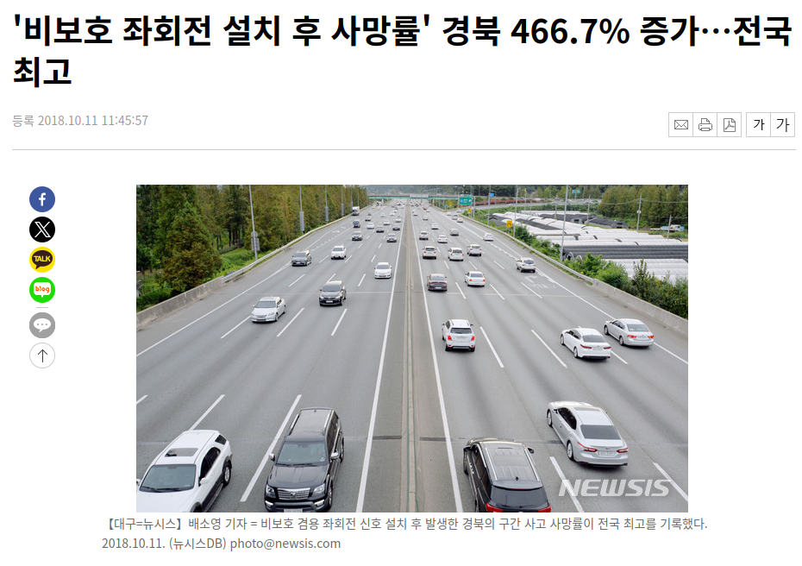
프로젝트 배경
비보호 표지판 개념 부족
거리판단 어려움
사고의 심각도 증가
실제로 많은 사람들 중
비보호 좌회전에 대해 정확히
모르는 사람이 많음
비보호 좌회전 시의 반대편 차량의 거리 판단을 제대로 하지 못해사고가 나는 경우가 빈번하게 발생
비보호 좌회전 사고시 반대 방향으로 주행중인 차량과의 사고가 빈번하기 때문에 사고의 심각도 증가

Slide 5
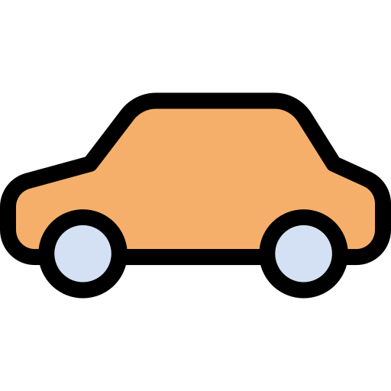
목표 및 기대효과
적색신호 시 비보호 불가
적색신호에서 좌회전을 할시에 경고를 주어 적색신호시에는 비보호를 하지 못하도록 안내함
건너편 차량 거리 인식
건너편 차량의 거리를 인식하여 비보호 좌회전을 할 수 있는 거리 인지 인식하여 위험을 알려줌
비보호 표지판 인식
비보호 표지판을 인식하여 비보호 좌회전이 가능한 사거리 인지 확인함
비보호 사고량 감소 및 개념 확립
비보호 좌회전에의한 사고량을 감소시키고 운전자에게 비보호 좌회전의 개념을 확립 시킴

Slide 6
팀구성 및 역할
김승민
박민혁
유지승
조수환
내용채우기
내용채우기
내용채우기
내용채우기

Slide 7
목차
60%
80%
프로젝트 수행
-데이터 수집 및 전처리
-AI모델학습
-기능구현
-UI개발
-시스템 통합
수행결과
-신호등,표지판인식 영상
-차량인식 영상
-테블릿 영상
-실제 차량 시현영상
20%
90%
프로젝트 구조
-시스템 구상도
-프로젝트 일정
사후평가
-어려웠던점
-느낀점
10%
100%
프로젝트 개요
-프로젝트 배경
-목표 및 기대효과
-팀구성 및 역할
QnA

Slide 8
프로젝트 구조

Slide 9
목차
60%
80%
프로젝트 수행
-데이터 수집 및 전처리
-AI모델학습
-기능구현
-UI개발
-시스템 통합
수행결과
-신호등,표지판인식 영상
-차량인식 영상
-테블릿 영상
-실제 차량 시현영상
20%
90%
프로젝트 구조
-시스템 구상도
-프로젝트 일정
사후평가
-어려웠던점
-느낀점
10%
100%
프로젝트 개요
-프로젝트 배경
-목표 및 기대효과
-팀구성 및 역할
QnA

Slide 10
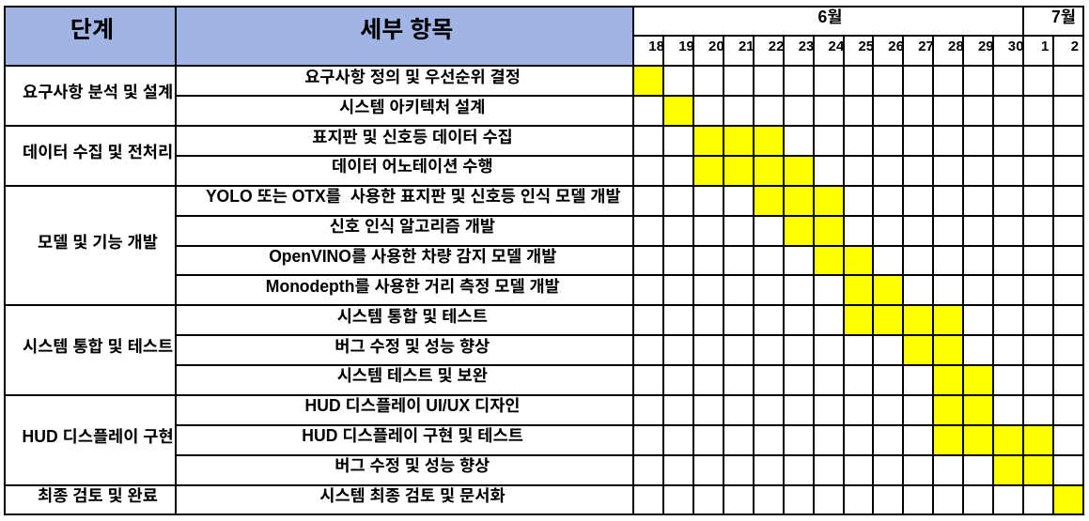
수행일정

Slide 11
모델 선정
Venus
Mars
Saturn
Venus has a beautiful name
Mars is actually a very cold place
Saturn is ringed and a gas giant
50%
95%
75%
80%
45%
35%
70%
30%
60%

Slide 12
모델 선정
Venus
Mars
Saturn
Venus has a beautiful name
Mars is actually a very cold place
Saturn is ringed and a gas giant
50%
95%
75%
80%
45%
35%
70%
30%
60%

Slide 13
프로젝트 구조

Slide 14
목차
60%
80%
프로젝트 수행
-데이터 수집 및 전처리
-AI모델학습
-기능구현
-UI개발
-시스템 통합
수행결과
-신호등,표지판인식 영상
-차량인식 영상
-테블릿 영상
-실제 차량 시현영상
20%
90%
프로젝트 구조
-시스템 구상도
-프로젝트 일정
사후평가
-어려웠던점
-느낀점
10%
100%
프로젝트 개요
-프로젝트 배경
-목표 및 기대효과
-팀구성 및 역할
QnA

Slide 15
신호등, 표지판 인식영상

Slide 16
차량 인식영상

Slide 17
테블릿 영상

Slide 18
실제 차량 시현영상

Slide 19
목차
60%
80%
프로젝트 수행
-데이터 수집 및 전처리
-AI모델학습
-기능구현
-UI개발
-시스템 통합
수행결과
-신호등,표지판인식 영상
-차량인식 영상
-테블릿 영상
-실제 차량 시현영상
20%
90%
프로젝트 구조
-시스템 구상도
-프로젝트 일정
사후평가
-어려웠던점
-느낀점
10%
100%
프로젝트 개요
-프로젝트 배경
-목표 및 기대효과
-팀구성 및 역할
QnA

Slide 20
느낀점
김승민
박민혁
Jupiter is a gas giant as well and it is also the biggest planet in the Solar System. It was named after a god
Saturn is the ringed planet. It is the sixth from the Sun and the second-largest in the Solar System
유지승
조수환
Despite being red, Mars is actually a cold place. Its atmosphere is full of iron oxide dust
Mercury is the smallest and the closest planet to the Sun. It was named after a Roman god

Slide 21
목차
60%
80%
프로젝트 수행
-데이터 수집 및 전처리
-AI모델학습
-기능구현
-UI개발
-시스템 통합
수행결과
-신호등,표지판인식 영상
-차량인식 영상
-테블릿 영상
-실제 차량 시현영상
20%
90%
프로젝트 구조
-시스템 구상도
-프로젝트 일정
사후평가
-어려웠던점
-느낀점
10%
100%
프로젝트 개요
-프로젝트 배경
-목표 및 기대효과
-팀구성 및 역할
QnA

Slide 22
QnA

Slide 23
Traffic Lights Infographics
VENUS
30%
Venus has a beautiful name, but it’s hot
MARS
70%
Mars is a actually a very cold place
SATURN
70%
Saturn is the ringed planet. It’s a gas giant

Slide 24
Traffic Lights Infographics
Venus
Mars
Saturn
Venus has a beautiful name
Mars is actually a very cold place
Saturn is ringed and a gas giant
50%
95%
75%
80%
45%
35%
70%
30%
60%

Slide 25
Traffic Lights Infographics
MARS
Despite being red, Mars is actually a very cold place. Its atmosphere is full of iron oxide dust
SATURN
Saturn is the ringed one. It’s a gas giant and it’s composed mostly of hydrogen and helium
VENUS
Venus has a beautiful name but it’s terribly hot. It’s the second planet from the Sun

Slide 26
Traffic Lights Infographics
STEP 1
STEP 1
Saturn is a gas giant and has several rings
Despite being red, Mars is actually a very cold place
STEP 2
STEP 2
Mercury is the smallest planet and the closest to the Sun
Venus has a nice name and is the second planet
STEP 2
STEP 2
Neptune is the farthest planet from the Sun
Jupiter is the biggest planet in the Solar System

Slide 27
Traffic Lights Infographics
NEPTUNE
URANUS
Neptune is the farthest from the Sun and the fourth-largest by diameter in the Solar System
Uranus is the seventh one from the Sun. It’s a gas giant too and it’s the coldest planet
MARS
SATURN
Mars is a very cold place. Its atmosphere is full of iron oxide dust, which makes it red
Saturn is the ringed one. It’s a gas giant and it’s composed mostly of hydrogen and helium
JUPITER
EARTH
Jupiter is a gas giant and the biggest planet in the Solar System. It was named after a god
Earth is the third planet from the Sun. It is the only planet known to have life on it so far

Slide 28
Traffic Lights Infographics
01
Neptune is the farthest from the Sun and the fourth-largest by diameter
Mars is a very cold place, not hot. Its atmosphere is full of iron oxide dust
02
03
Jupiter is a gas giant as well and the biggest planet in the Solar System

Slide 29
Traffic Lights Infographics
VENUS
SATURN
MARS
Venus has a beautiful name
Saturn is the ringed planet
Mars is actually a cold place
MERCURY
JUPITER
EARTH
Mercury is the smallest planet
Jupiter is a gas giant as well
This is where we live on

Slide 30
Traffic Lights Infographics
VENUS
SATURN
MARS
Venus has a beautiful name. It’s the second planet from the Sun
Saturn is a gas giant and it’s composed of hydrogen and helium
Mars is actually a cold place. Its atmosphere is full of iron oxide dust

Slide 31
Traffic Lights Infographics
01
MARS
Despite being red, Mars is actually a cold place
02
SATURN
It’s the ringed one. It’s composed of hydrogen and helium
03
VENUS
Venus has a beautiful name, but it’s terribly hot

Slide 32
BackGround
비보호 표지판 개념 부족
Jupiter
Earth
Saturn is composed mostly of hydrogen and helium. It’s the ringed planet and a gas giant
Jupiter is the biggest planet in the Solar System. It is a gas giant too and it was named after a god
Earth is the third planet from the Sun. So far, it’s the only planet that harbors life

Slide 33
Traffic Lights Infographics
02
03
04
Saturn is a gas giant. It’s the ringed planet
Jupiter is a gas giant and the biggest planet
Uranus is a gas giant and the coldest planet
01
05
Neptune is the farthest and fourth-largest
Earth is actually the third planet from the Sun

Slide 34
Traffic Lights Infographics
Saturn
Saturn is composed mostly of hydrogen and helium. It’s the ringed planet and a gas giant
Mercury
Mercury is small and is the closest planet to the Sun. It was named after a Roman god
Jupiter
Jupiter is a gas giant as well and is also the biggest planet in the Solar System

Slide 35
Traffic Lights Infographics
01
02
03
Mercury
Jupiter
Saturn
Mercury is the smallest and the closest planet to the Sun in the Solar System
Jupiter is a gas giant too and the biggest planet. It was named after a Roman god
Saturn is composed mostly of hydrogen and helium. It is a ringed gas giant

Slide 36
Traffic Lights Infographics
VENUS
Venus has a beautiful name but it’s terribly hot. It’s the second planet from the Sun
SATURN
Saturn is the ringed one. It’s a gas giant composed mostly of hydrogen and helium
MARS
Despite being red, Mars is a cold place. Its atmosphere is full of iron oxide dust

Slide 37
Traffic Lights Infographics
Earth is the third from the Sun
Jupiter is a gas giant as well
Mercury is the smallest planet
SATURN
It’s composed hydrogen and helium
Uranus is the coldest planet
Mars is red and a cold place
Neptune is the farthest one

Slide 38
Traffic Lights Infographics
Saturn
Saturn is composed mostly of hydrogen and helium. It’s the ringed planet and a gas giant
Mercury
Mercury is small and it’s the closest planet to the Sun. It was named after a Roman god
Jupiter
Jupiter is a gas giant as well and it is also the biggest planet in the Solar System

Slide 39
Traffic Lights Infographics
VENUS
Venus has a nice name and is the second planet from the Sun
NEPTUNE
Neptune is the farthest from the Sun and the fourth-largest
EARTH
Earth is the third planet from the Sun. It is the only planet known to have life

Slide 40
Traffic Lights Infographics
Neptune
Saturn
Earth
Uranus
Neptune is the farthest planet from the Sun
Saturn is the ringed one and a gas giant
Earth is in fact the third planet from the Sun
Uranus is cold and seventh from the Sun
01
02
03
04

Slide 41
Traffic Lights Infographics
01
SATURN
Saturn is composed mostly of hydrogen and helium. It’s the ringed planet and a gas giant
02
JUPITER
Jupiter is a gas giant as well and it is also the biggest planet in the Solar System

Slide 42
Traffic Lights Infographics
Saturn is the ringed one and also a gas giant
Earth is actually the third planet from the Sun
01
04
Jupiter is the biggest planet in the Solar System
Uranus is the coldest planet in the Solar System
02
05
Neptune is the fourth-largest planet of them all
Venus is very hot and the second from the Sun
03
06

Slide 43
Traffic Lights Infographics
VENUS
65%
Venus has a nice name and is the second planet from the Sun
SATURN
22%
Saturn is ringed and composed of hydrogen and helium
MARS
90%
Mars is cold and its atmosphere is full of iron oxide dust

Slide 44
Traffic Lights Infographics
MERCURY
It’s the closest planet to the Sun
SATURN
It’s composed of hydrogen and helium
VENUS
Venus has a poisonous atmosphere
JUPITER
It’s a gas giant in the Solar System
MARS
Mars is full of iron oxide dust
EARTH
Earth is the planet where we live on

Slide 45
Traffic Lights Infographics
Mercury
Venus
Saturn
Mars
Mercury is the closest planet to the Sun and is only a bit larger than the Moon
Venus has a nice name, it’s hot and it is the second planet from the Sun
Saturn is the ringed one. It’s composed mostly of hydrogen and helium
Despite being red, Mars is actually a cold place. It’s full of iron oxide dust

Slide 46
Traffic Lights Infographics
Mercury
Venus
Saturn
Mercury is the closest planet to the Sun and is only a bit larger than the Moon
Venus has a nice name, it’s hot and it is the second planet from the Sun
Saturn is the ringed one. It’s composed mostly of hydrogen and helium

Slide 47
Traffic Lights Infographics
VENUS
Venus has a beautiful name but it’s terribly hot. It’s the second planet from the Sun
SATURN
Saturn is the ringed one. It’s a gas giant composed mostly of hydrogen and helium
MARS
Despite being red, Mars is a cold place. Its atmosphere is full of iron oxide dust

Slide 48
Traffic Lights Infographics
Venus was named after a goddess, it’s hot and it is the second planet from the Sun
01
Saturn is the ringed one. It is composed mostly of hydrogen and helium
02
Despite being red, Mars is actually a cold place. It’s full of iron oxide dust
03

Slide 49
Traffic Lights Infographics
Mercury
Venus
Mercury is the smallest, only a bit larger than the Moon
Venus it’s hot and it is the second planet from the Sun
Saturn
Mars
Saturn is composed mostly of hydrogen and helium
Mars is actually a cold place. It’s full of iron oxide dust

Slide 50
Traffic Lights Infographics
Mars
Saturn
Venus
Mercury
Mars is a cold place. It’s full of iron oxide dust
It’s composed of hydrogen and helium mostly
Venus has a beautiful name but it’s very hot
Mercury is small, only a bit larger than the Moon

Slide 51
Instructions for use (premium users)
In order to use this template, you must be a Premium user on Slidesgo.
You are allowed to:
Modify this template.
Use it for both personal and commercial purposes.
Hide or delete the “Thanks” slide and the mention to Slidesgo in the credits.
Share this template in an editable format with people who are not part of your team.
You are not allowed to:
Sublicense, sell or rent this Slidesgo Template (or a modified version of this Slidesgo Template).
Distribute this Slidesgo Template (or a modified version of this Slidesgo Template) or include it in a database or in any other product or service that offers downloadable images, icons or presentations that may be subject to distribution or resale.
Use any of the elements that are part of this Slidesgo Template in an isolated and separated way from this Template.
Register any of the elements that are part of this template as a trademark or logo, or register it as a work in an intellectual property registry or similar.
For more information about editing slides, please read our FAQs or visit Slidesgo School:
https://slidesgo.com/faqs and https://slidesgo.com/slidesgo-school

Slide 52
Infographics
You can add and edit some infographics to your presentation to present your data in a visual way.
Choose your favourite infographic and insert it in your presentation using Ctrl C + Ctrl V or Cmd C + Cmd V in Mac.
Select one of the parts and ungroup it by right-clicking and choosing “Ungroup”.
Change the color by clicking on the paint bucket.
Then resize the element by clicking and dragging one of the square-shaped points of its bounding box (the cursor should look like a double-headed arrow). Remember to hold Shift while dragging to keep the proportions.
Group the elements again by selecting them, right-clicking and choosing “Group”.
Repeat the steps above with the other parts and when you’re done editing, copy the end result and paste it into your presentation.
Remember to choose the “Keep source formatting” option so that it keeps the design. For more info, please visit Slidesgo School.

